Slide 1

ITIL® 4 Foundation Certification Course
Lesson 1: Introduction to Service Management and ITIL®
Based on AXELOS ITIL® material.
ITIL® is a [registered] trade mark of AXELOS Limited.

Slide 2


Learning Objectives
By the end of this lesson, you will be able to:
Identify the significance of IT service management in the modern world
Discover the goals of ITIL® 4 foundation
Describe the structure and benefits of ITIL® 4 framework

Slide 3



Introduction to Service Management and ITIL
Topic 1: Significance of IT Service Management

Slide 4




Introduction to IT Service Management
Services enable organizations to create
value for themselves and their customers.
They comprise the largest and dynamic
component of all economies.
They offer huge benefits for organizations in creating, expanding, and improving their IT service management capability.
All services are
IT enabled.

Slide 5

Introduction to IT Service Management
Technology is advancing fast today.

Slide 6
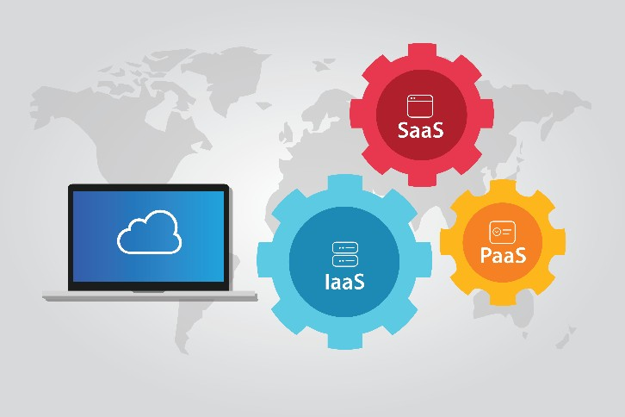
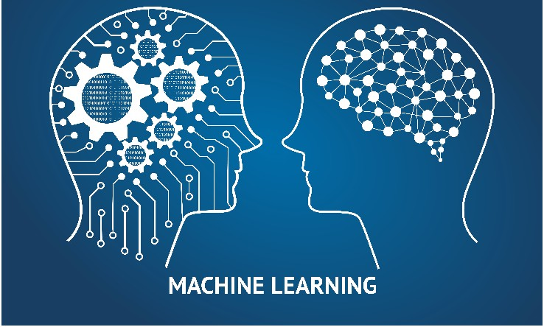





Introduction to IT Service Management
Cloud computing
Infrastructure as a Service (IaaS)
Machine Learning
Blockchain
Opened opportunities
for value creation
Made IT an important business driver
Transformed IT as a source of competitive advantage

Slide 7

Introduction to IT Service Management
Organizations are undertaking digital transformation to exploit the digitization opportunities.
The organizational needs for stability, predictability, operational agility, and increased velocity must be balanced with digital transformation.
Increased velocity
Operational agility
Predictability
Digitization
Stability

Slide 8
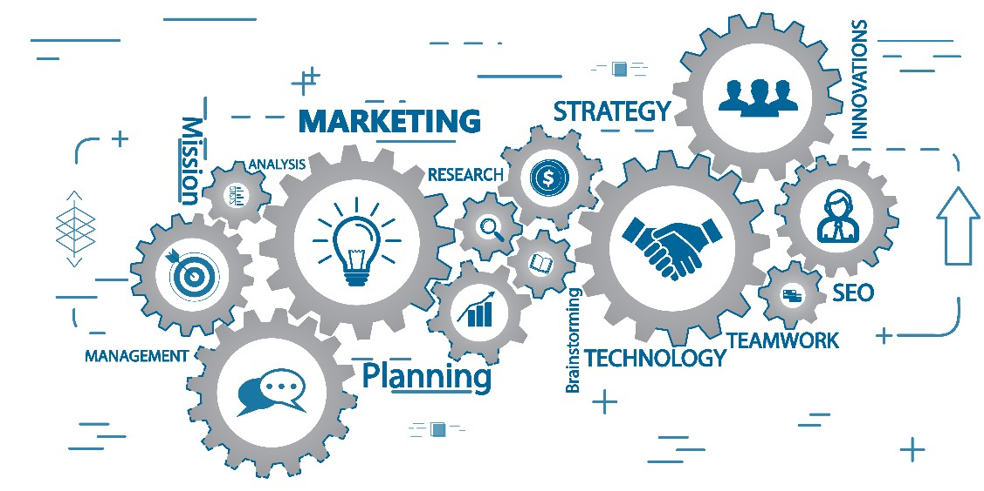



Introduction to IT Service Management
Information and technology are being integrated with other organizational capabilities.
Cross-functional teams are becoming popular.
Service management is evolving to support the organizational shift.
The most widely adopted guidance on IT
Service Management (ITSM) is evolving

Slide 9
Introduction to Service Management and ITIL
Topic 2: Goals of ITIL 4 Foundation

Slide 10

About ITIL
ITIL leads the ITSM industry with guidance, training, and certification programs.
ITSM

Slide 11

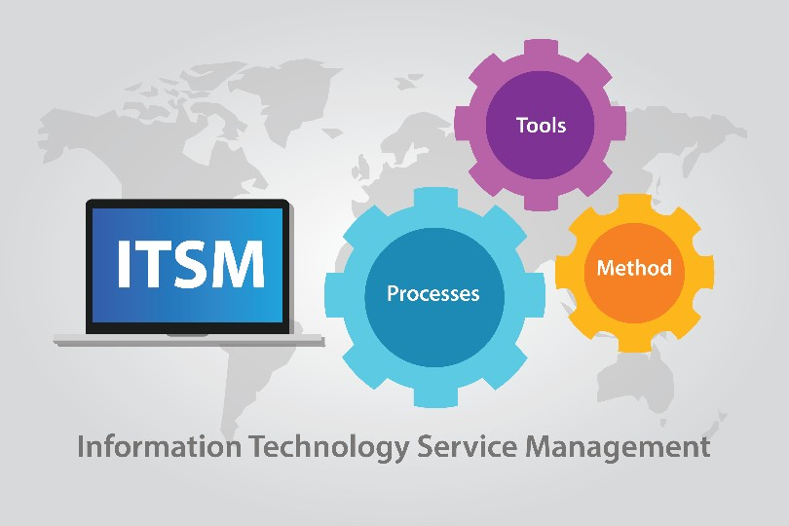


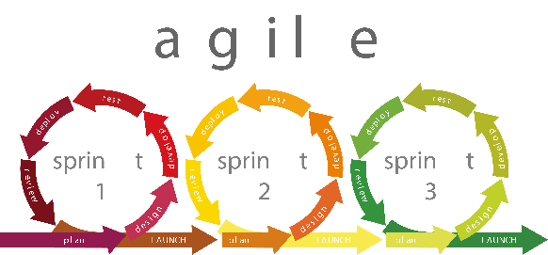
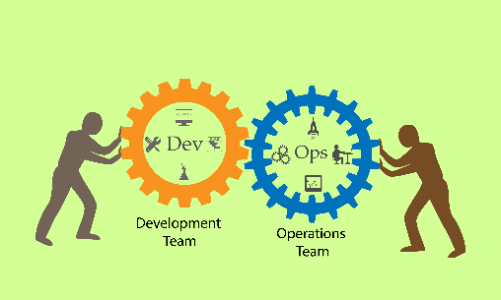
ITIL 4: Benefits for Organization
Reshapes ITSM practices in the wider context of customer experience, value streams, and digital transformation
Ensures flexible, coordinated, and integrated system for effective governance of IT Enabled Services (ITeS)
Embraces new ways of working
Provides guidance to address service management challenges
Lean
Agile
DevOps

Slide 12




ITIL 4: Benefits for Professionals
Introduces readers to the management and key concepts of modern IT enabled services
Acts as a reference guide to be used in work, study, and professional development
Guides professionals on how they can improve their and their organization’s capabilities
Elaborates the concepts of service management framework for the ITIL Foundation exam
Provides an overview of the ITIL 4 framework and how it adopts modern technologies and ways of working

Slide 13
Introduction to Service Management and ITIL
Topic 3: Structure and Benefits of ITIL 4 Framework

Slide 14
ITIL 4 Framework
The key components of ITIL® 4:
Service Value System (SVS)
Four Dimensions Model

Slide 15
ITIL 4 Framework
The key components of ITIL® 4:
Service Value System (SVS)
Four Dimensions Model

Slide 16
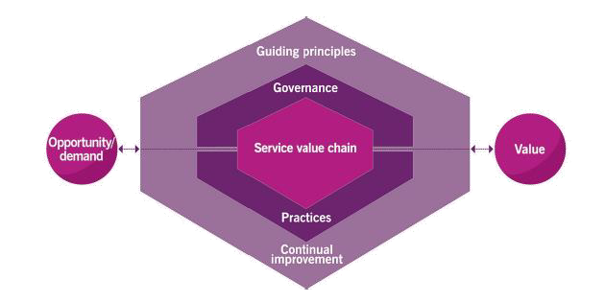
ITIL SVS
The ITIL SVS represents how the various components and activities of the organization work together to facilitate value creation through IT enabled services.
Figure 1.1 The service value system

Slide 17
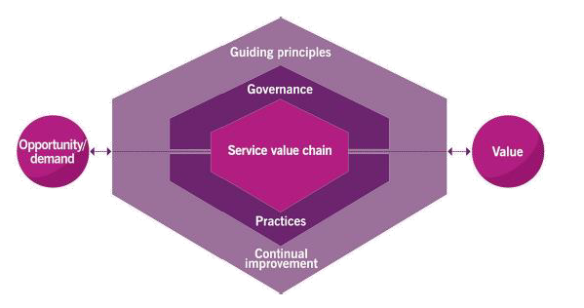
ITIL SVS
The components and activities can be combined in a flexible way.
ITIL SVS facilitates integration and coordination of various organizational components and activities.
It provides a strong, unified, and value- focused direction for the organization through IT enabled service.
Figure 1.1 The service value system

Slide 18
Core Components of ITIL SVS
3. ITIL guiding principles
1. ITIL service value chain
4. Governance
2. ITIL practices
5. Continual improvement
Figure 1.1 The service value system

Slide 19

Core Components of ITIL SVS
1. ITIL service value chain
Provides an operating model for the creation, delivery, and continual improvement of services
Defines six key activities that can be combined in many ways, forming multiple value streams
Can be adapted to multiple approaches, including DevOps and centralized IT, to address the need for multimodal service management
Figure 1.1 The service value system

Slide 20
Core Components of ITIL SVS
2. ITIL practices
Enhance the flexibility of SVS
Support multiple service value chain activities, providing a comprehensive and versatile toolset for ITSM practitioners
Figure 1.1 The service value system

Slide 21
Core Components of ITIL SVS
3. ITIL guiding principles
Guide an organization’s decisions and actions
Ensure a shared understanding and common approach to service management across the organization
Create the foundation for an organization’s culture and behavior
Figure 1.1 The service value system

Slide 22
Core Components of ITIL SVS
4. Governance
Enables organizations to continually align their operations with the strategic direction set by the governing body
Figure 1.1 The service value system

Slide 23
Core Components of ITIL SVS
5. Continual improvement
Supports all other components of the ITIL SVS
Is a simple and practical improvement model
Maintains the resilience and agility of all components
in a constantly changing environment
Figure 1.1 The service value system

Slide 24
ITIL 4 Framework
The key components of ITIL® 4:
Service Value System (SVS)
Four Dimensions Model
Four Dimensions Model

Slide 25
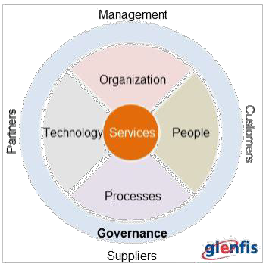
The Four Dimensions Model
ITIL 4 outlines the four dimensions of service management, from which each component of the SVS should be considered.
1. Organizations and people
2. Information and technology
3. Partners and suppliers
4. Value streams and processes
An organization ensures that the SVS remains balanced and effective by giving each of the four dimensions an appropriate amount of focus.

Slide 26
Key Takeaways
Service management is changing to address and support the organizational shift and ensure that the opportunities from new technologies are maximized. ITIL has led the ITSM industry with guidance, training, and certification programs for more than 30 years.
The key components of the ITIL 4 framework are the ITIL service value system
(SVS) and the four dimensions model.
The ITIL SVS represents how the various components and activities of the organization work together to facilitate value creation through IT enabled services.
The four dimensions of service management are organizations and people, information and technology, partners and suppliers, and value streams and processes.

Slide 27
Thank You
ITIL® 4 Foundation Certification Course
Based on AXELOS ITIL® material.
ITIL® is a [registered] trade mark of AXELOS Limited.

